Slide 1
Simulating the Evolution of Aggression
By Kyle Dukart and William Simcox
Notes:
W
Alright so were going to talk about our project, which is simulating the evolution of aggression. By Kyle Dukart and William Simcox.

Slide 2
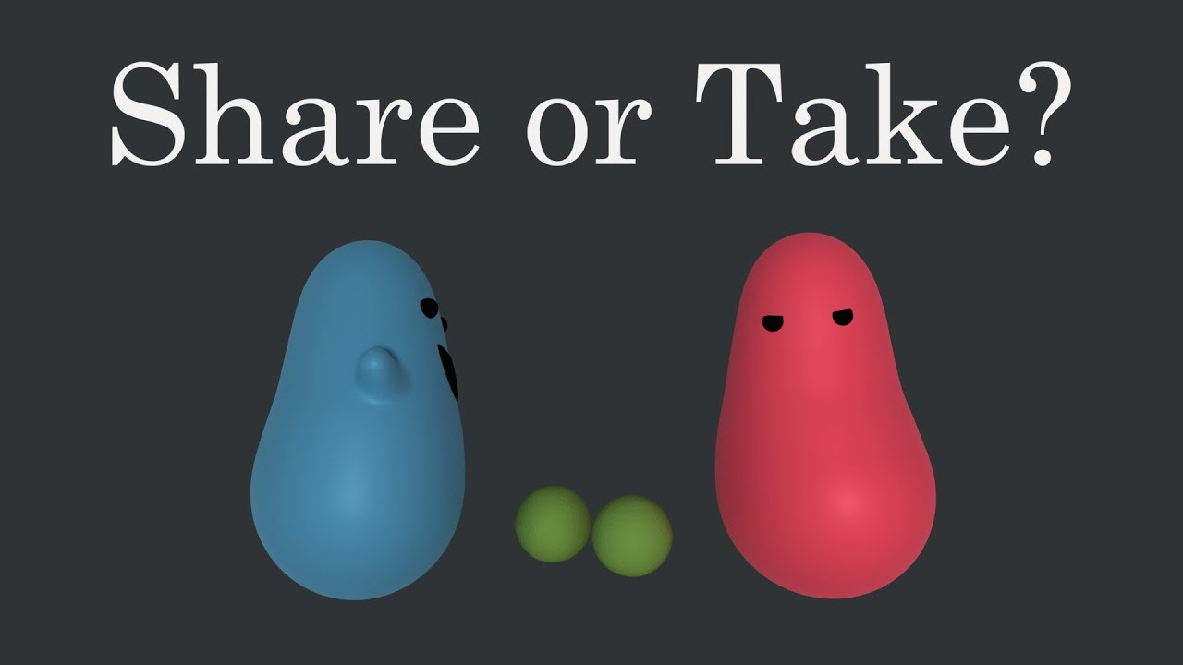
Goal of Our Project
The main goal of our project was to create a simulation of the evolution of aggression in two populations competing against each other for food.
Inspiration: Primer on Youtube
https://www.youtube.com/watch?app=desktop&v=YNMkADpvO4w
Notes:
W
The main goal of our project was to create a simulation of the evolution of aggression in two populations competing against each other for food. We took inspiration from a youtuber named Primer who did something similar with just Hawks and Doves but we wanted to expand on his idea. I recommend watching his video on Youtube, it’s pretty entertaining.

Slide 3
Libraries Used
The Libraries that were used in this project were:
Numpy
Matplotlib
Colorama
Python Standard Library
Random
Copy
Argparse
Sys
Notes:
W The libraries that were used was Numpy and matplotlib for graphing. Colorama for some special colored text for readability and fun. We also used Python’s standard library which include random, copy, argparse, and system.

Slide 4

Tools Used
Repl.it
Discord
Google Docs
Google Slides
Youtube
repl.it
Link to our repository: https://repl.it/@Shucadoodle/Project2#main.py
Notes:
W
The tools that we utilized for our project were, repl.it, Discord, google docs, slides, and youtube.
Repl.it is a free online IDE which users can code in real time together.
Here is a link to our repository.
https://repl.it/@Shucadoodle/Project2#main.py

Slide 5
Simulation Basics
Agents
Each has a game theory strategy
Food
Each food holds up to 2 agents
Generation
The simulation is run over N number of generations
Notes:
K

Slide 6
Simulation Workflow
Get simulation parameters from argparse or user
Create list of Agents, each with their own strategy
For each generation:
Assign each Agent to a Food
Determine how much food each Agent receives (compete)
Determine if each agent dies or reproduces
Notes:
K

Slide 7
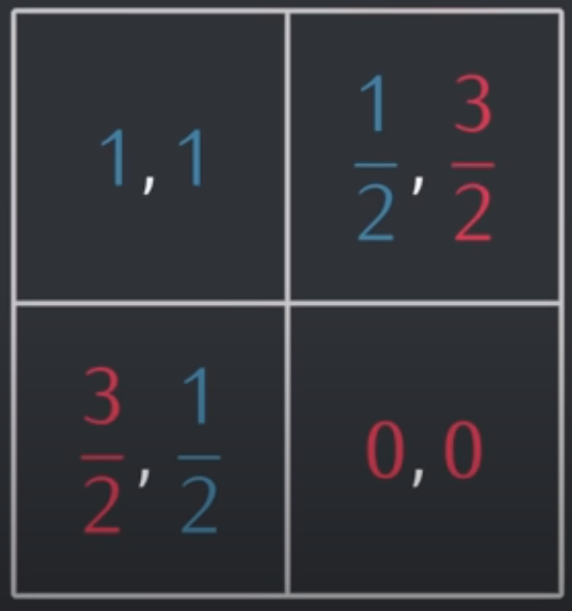
Agent Payout
When agents compete, their rewards are determined by a payout matrix
Agents die or reproduce depending on the number of food they have
0 food = death
½ food = 50% chance of death
1 food = survival
1 ½ food = 50% chance to reproduce
2 food = 100% chance to reproduce
Notes:
K

Slide 8
Available Strategies
Available strategies:
Dove (always cooperate)
Hawk (always defect)
TitForTat (cooperate on first round, then imitate opponent's last move)
AngryTitForTat (defect on first move, then imitate opponent's last move)
Random (50% chance to cooperate)
RandomDove (80% chance to cooperate)
RandomHawk (20% chance to cooperate)
Grim (cooperates until opponent defects, then always defects)
TitForTwoTats (if opponent defects twice in a row, then defect. Otherwise cooperate)
Notes:
K

Slide 9
Example Competition
Agent 1: RandomDove (80% chance to cooperate)
Randomly choose to cooperate
2. Randomly choose to defect
3. Randomly choose to defect
Agent 2: Grim (cooperate until opponent defects, then always defect)
Always cooperate at start
2. Cooperate
3. Opponent defected, always defect
Both Agents cooperate, each receives a payout of 1 food
Agent 1 receives 1.5 food, Agent 2 receives 0.5 food
Both Agents receive 0 food
Notes:
K

Slide 10
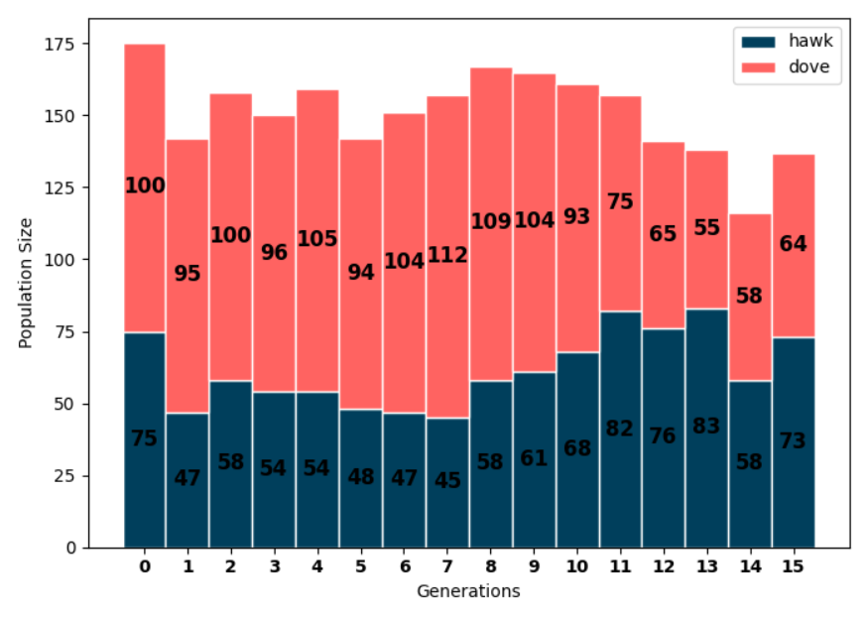
Input/Output Example:
First population size: 75
Second population size: 100
Amount of food present: 100
First population strategy: Hawk
Second population strategy: Dove
Number of generations: 15
Notes:
W
In this example the hawks population starts lower than the amount of doves but they start to win at around generation 11. This is because hawks have a higher chance of competing with doves more than each other which results in a higher payout. If there were more hawks than doves then you would see the doves win.

Slide 11
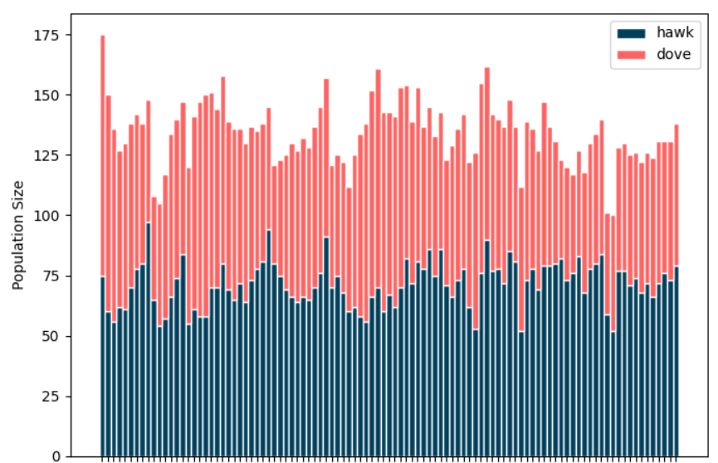
Input/Output Example (continued):
Number of generations: 100
Notes:
W
Hawks beat doves, but hawks competing against each other frequently will result in them dying off due more defecting and lower payouts.

Slide 12
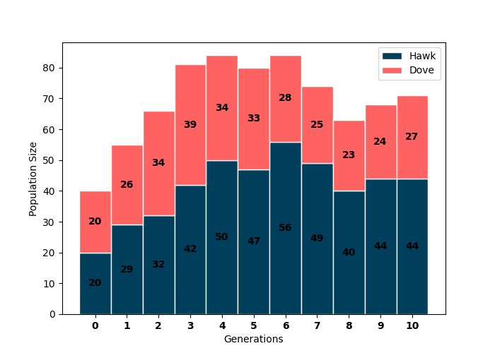
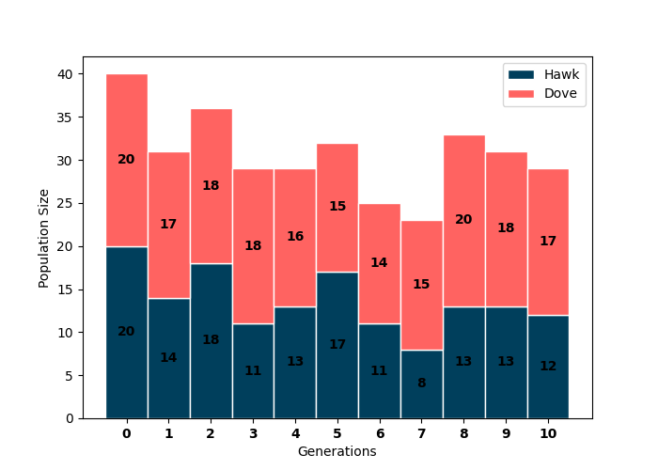
Interesting Simulations
20 hawk vs 20 dove
60 food
20 food
Notes:
K

Slide 13
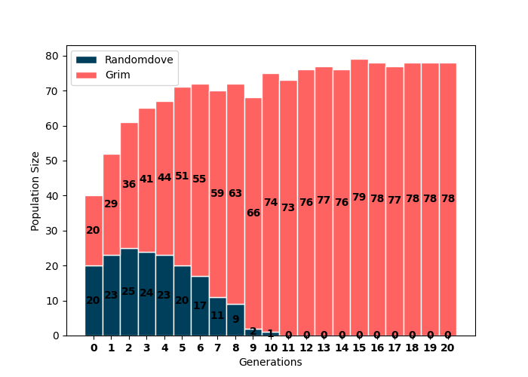
Interesting Simulations
20 randomdove vs 20 grim
Notes:
K

Slide 14
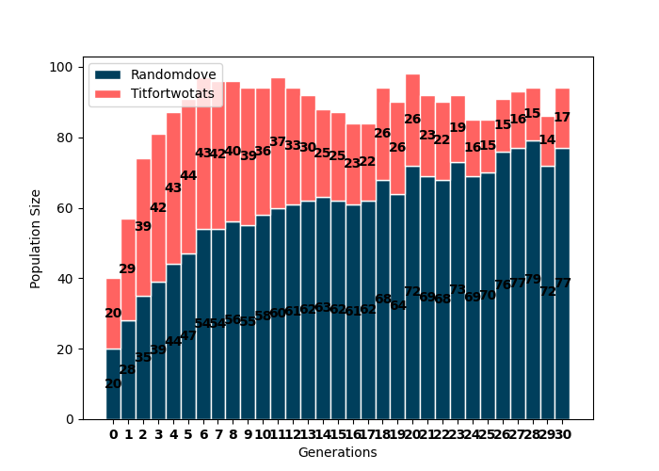
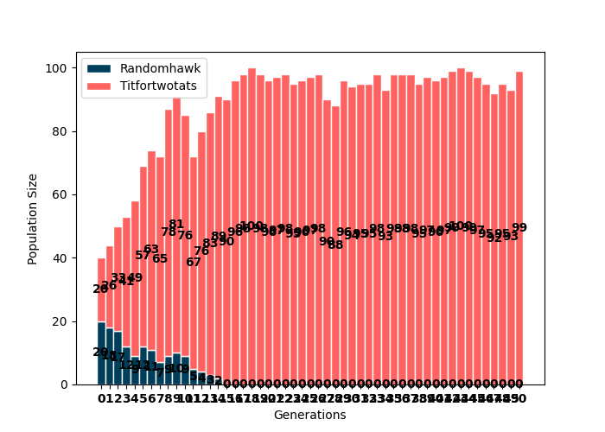
Interesting Simulations
Randomdove vs titfortwotats
Randomhawk vs titfortwotats
Notes:
K

Slide 15
Questions or Comments?
Notes:
K

